Slide 1
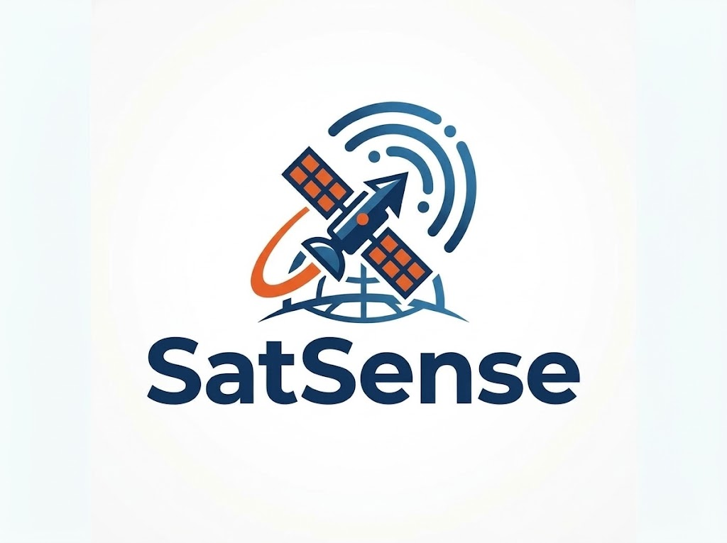


SMART INDIA HACKATHON 2026
Problem Statement ID- 26167
Problem Statement Title- SatQuery AI - An Interactive
Vision-Language Assistant for Multimodal Remote
Sensing Image Analysis through Text Queries
Theme- Space Technology
Organization- Indian Space Research
Organisation(ISRO)
PS Category- Software
Team ID- 148995
Team Name- SatSense

Slide 2
SatQuery AI
PROBLEM HOOK
PROPOSED SOLUTION
INNOVATION & UNIQUENESS
All-Weather Satellite Analysis — Fuses Cartosat-2S optical with RISAT-1/1A C-band SAR; microwaves penetrate monsoon cloud cover 100%, day or night.
Deterministic Area Measurement — Area (km²) = (N_pixels × GSD_x × GSD_y) / 1,000,000, computed directly from GeoTIFF affine metadata — never estimated by the AI.
Honest Refusal Engine — If CRS mismatch, <80% spatial overlap (IoU), or >80% cloud cover without a SAR pair, the system halts and states the exact reason instead of hallucinating.
Visual Proof, Not Just Text — Every answer ships with an interactive Agreement / Disagreement map showing exactly where optical and radar evidence agree or conflict.
Elevation-Gated Radar:
Uses terrain height and slope information to prevent mountain shadows, slopes and flat surfaces from being incorrectly identified as flooded areas.
Actionable Disagreement Maps:
Compares optical and SAR satellite images to find areas where one image may miss flooding, especially under heavy cloud cover.
Deterministic Number Guard:
All important measurements, such as flooded area, are calculated directly from geospatial data instead of being guessed by AI.
Offline Tactical Field Packs:
Creates a ready-to-use package containing maps, detected areas and supporting evidence that field teams can access even without internet.
"During Assam's monsoon floods, NDRF coordinators can't get a fast, trustworthy answer to 'how much land is underwater?' Regular AI models can't read satellite coordinates or calculate real ground area — and a manual assessment currently takes ~4 hours, with monsoon clouds blocking optical satellites roughly 78% of the time."
CORE PHILOSOPHY
Understand → Check → Choose → Analyze → Verify → Explain
SatQuery AI is a "Careful Coordinator," not a black-box chatbot — it validates data before it analyzes, and refuses honestly rather than guessing.

Slide 3
TECHNICAL APPROACH
METHODOLOGY & PROCESS
OF IMPLEMENTATION
SYSTEM ARCHITECTURE
USER / WEB UI - questions • image upload • AOI • interactive map • results
1
UNDERSTAND
Natural-language question is parsed into a typed Query Contract (Pydantic v2): intent, sensor, dates, output.
Query Contract
Pydantic v2 typed task schema:
intent • sensor • dates • output
Data Readiness Gate
CRS • affine • GSD • cloud/QA
footprint IoU • temporal match
Workflow Registry
Rules + deterministic routing
to certified specialist tools
Evidence Store
Evidence IDs, provenance,
model + version, timestamps
2
CHECK
Data Readiness Gate validates CRS / EPSG, affine transform, GSD, cloud cover and footprint overlap (IoU >= 0.20).
Ingest & Preprocess
rasterio • reproject • clip
co-register • sigma0 + Refined Lee
Specialist Models
RS-VLM VQA • grounding
Siamese change • Optical-SAR fusion
GIS Verification
area • overlap • geometry
raster-to-vector GeoJSON
Evidence Arbiter
optical vs SAR agreement,
disagreement + reference check
3
CHOOSE
Deterministic router selects the certified specialist model from the registry - no free-form LLM tool calling.
Optical Evidence
water / change mask
+ confidence + timestamp
SAR Evidence
backscatter change mask
+ confidence + timestamp
ERI
HIGH • MEDIUM • LOW
INSUFFICIENT • CONFLICTING
Audit Trace
step ID, tool, parameters,
latency, status (JSON)
ANALYSE
Specialist tools run: RS-VLM VQA, text-guided grounding, Siamese change detection, Optical-SAR fusion.
FINAL RESPONSE - answer + map + measurements + limitations + audit
GRACEFUL REFUSAL - nothing fabricated
4
TECHNOLOGIES USED
VERIFY
GIS math converts masks to km2; cross-modal agreement and harmonic confidence produce the ERI state.
UI
Frontend
API
Backend
ML
AI / ML Models
5
HTML5 + Vanilla ES6. Leaflet.js side-by-side swipe viewer, layer toggles, live trace terminal.
Python 3.11, FastAPI + Uvicorn. Async ingestion; /api/query, /validate, /presets, /export.
PyTorch. LoRA-tuned RS-VLM, grounding head, Siamese ChangeFormer, Optical-SAR.
EXPLAIN
Answer + map overlays + measurements + limitations + JSON execution trace and PDF / GeoJSON export.
GIS
Geospatial
DATA
Data & Sensors
OPS
Deployment
6
rasterio, GDAL, pyproj, shapely, geopandas, OpenCV. RFC 7946 GeoJSON for QGIS.
Cartosat-2S optical + RISAT-1/1A SAR. BigEarthNet, VRSBench, RSVQA, CDVQA.
Docker. Air-gapped on-premise or GPU cloud. ReportLab PDF intelligence dossier.
Notes:
Technical Approach. Left: six-stage methodology - Understand, Check, Choose, Analyse, Verify, Explain. Right: the layered system architecture from the web UI down through the query contract, readiness gate, specialist models, GIS verification and evidence arbiter to either a verified response or a graceful refusal. Below it, the technology stack. Link the Report / GitHub buttons before submitting.

Slide 4
FEASIBILITY AND VIABILITY
FEASIBILITY
CHALLENGES & RISKS
VIABILITY
MITIGATION STRATEGIES
Built on open-source tooling (Pydantic, Rasterio, PyTorch, FastAPI) and pre-trained models (GeoChat, NASA OPERA) — no costly training run needed.
Data sources are free & public — ISRO Bhuvan, NDMA, Copernicus, USGS, NASA Earthdata — zero licensing cost.
Ongoing cost is modest, usage-scaled GPU inference. Validated on RSVQA / VRSBench / CDVQA / SEN12 - Flood — <1% geocoding error.
Cloud & Weather — Optical images may be blocked by clouds, haze or darkness. Use SAR for continuous observation.
False Detection — SAR noise, terrain and similar surfaces can cause false flood detection. Use filtering and terrain checks.
Image Misalignment — Images from different dates may not line up correctly. Automatically align images before comparison.
Data & Processing Limits — Large images or missing data can affect speed and accuracy. Use efficient processing and data-quality checks.
Practical to Build — Uses existing AI, satellite and GIS technologies.
Works With Real Data — Can use ISRO satellite imagery such as Cartosat and RISAT.
Scalable — Can be extended to different regions, disasters and satellite datasets.
Field-Ready — Can provide maps, reports and offline results for disaster-response teams.
Future-Ready — Can support more satellite sensors and AI models as they become available.
Multi-Sensor Fusion — Combines optical and SAR images to maintain visibility through clouds and darkness.
Noise & Terrain Filtering — Reduces false flood detection caused by radar noise, hills and similar surfaces.
Accurate Image Alignment — Aligns images from different dates before comparison to prevent false change detection.
Smart Processing & Data Checks — Processes large images efficiently and checks data quality before analysis to avoid unreliable results.

Slide 5



IMPACT AND BENEFITS
IMPACT AND BENEFITS
Metric | Before (manual GIS) | After (SatQuery AI)
Analysis time | ~4 hrs (GIS scientist in QGIS / ArcGIS) | Minutes, automated
Area accuracy | Estimated, scientist-dependent | Within ~1% of certified GIS reference
Cloud-blocked scenes | No usable answer (78% cloud cover = blind) | 100% ground visibility (SAR fusion)
Expertise needed | Remote-sensing / GIS specialist | Any officer, via plain-English query
Assam demo result | Flood extent unknown under cloud | 11.20 km² hidden flood revealed; 18.40 km² (1,840 ha) total measured
Helps disaster teams quickly identify
flooded areas and plan rescue operations
Faster response
Reduces disaster analysis from hours to minutes.
Time
Efficiency
Support
Replaces AI guesswork
with certified ground measurements
Provides maps and results that
can be used even in areas with
poor or no internet.
Accuracy
IMPACTS
BENEFITS
Quickly measures affected farmland and other damaged areas for relief and compensation.
Enables non-experts to
run satellite analysis in
simple English.
Assessment
Accessibility
SDG 9 (Industry & Innovation): Covers Infrastructure Bodies & Civil Officers → for bridge/road monitoring and zero-code satellite intelligence.
SDG 11 (Sustainable Cities): Covers Municipalities & Disaster Agencies → for urban growth tracking and disaster safety.
SDG 13 (Climate Action): Covers Farmers, Agricultural Boards & Forestry Teams → for crop loss assessment and environmental change tracking.
Allows non-technical officials to analyse
satellite images using simple questions,
without needing advanced GIS skills.
User
Friendly
Recovers 100% of ground data hidden under storm clouds using radar
Reliability

Slide 6
RESEARCH AND REFERENCES
BigEarthNet.
txt (2026)
Remote Sensing Vision-Language Benchmark
GeoChat (2024)
Vision-Language AI for Remote Sensing
Foundation Models for Geospatial AI (2024)
Multi-Modal & Multi-Sensor Remote Sensing AI EarthGPT (2024)
Change Detection & Visual Question Answering (CDVQA 2022)
LINK
LINK
LINK
LINK
LINK
CDVQA: Yuan et al., IEEE TGRS 2022
EarthGPT: Zhang et al., IEEE TGRS 2024
Foundation Models: Jakubik et al., arXiv:2310.18660
GeoChat: Kuckreja et al., CVPR 2024
BigEarthNet.txt: Herzog et al., arXiv:2603.29630
Research Evidence (Validation & Benchmarking)
Digital Sources (Official & Standards Bodies)
Experimental Results: <1% geocoding coordinate error via deterministic affine transforms.
Benchmarking: RSVQA, VRSBench, CDVQA, SEN12-Flood - trained on 590K+ Sentinel-1/2 patches (BigEarthNet.txt).
Validation: 100% cloud penetration verified under 80%+ monsoon cloud cover vs. ground flood atlases.
Government Portals: ISRO Bhuvan GeoAI, National Disaster Management Authority (NDMA).
Standards Organizations: Open Geospatial Consortium (OGC) STAC API v1.0, RFC 7946 GeoJSON.
Reputable Repositories: ESA Copernicus SciHub, USGS EarthExplorer, NASA Earthdata.

